Slide 1
Assignment – Decision Tree
Submitted By: Pooran Pragnya
November Batch (BDS)

Slide 2
Decision Tree
A decision tree is a decision support tool uses a tree-like model of decisions and their possible consequences including chances event outcomes, resources costs and utility.
It works on the sum of product form which is also known as ‘Disjunctive Normal Form’.
It is a type of algorithm that includes ‘conditional’, ‘control’ statements to clarify data.
It can be used for both classification as well as regression problems.

Slide 3
Decision Tree - As a Tree Structure
A decision tree is a tree where each node represents a feature (attribute), each link (branch) represents a decision (rule) and each represents an outcome categorical or continuous data/values.
The top most decision (made) node in tree which corresponds to the best predictor called root node.
A whole idea is to create a tree like this for the entire data and process a single outcome at every leaf (or minimize the error in every leaf).

Slide 4
Decision Tree Consists of:
1. Nodes: Test for the Value of a certain attributes.
2. Edges/branch: Correspond to the outcome of a test and connect to the next node or leaf.
3. Leaf Node: Terminal nodes that predict the outcome (represent class label/class distribution).
4. Root Node: It is the top most node in tree which corresponds to the best predictor.

Slide 5
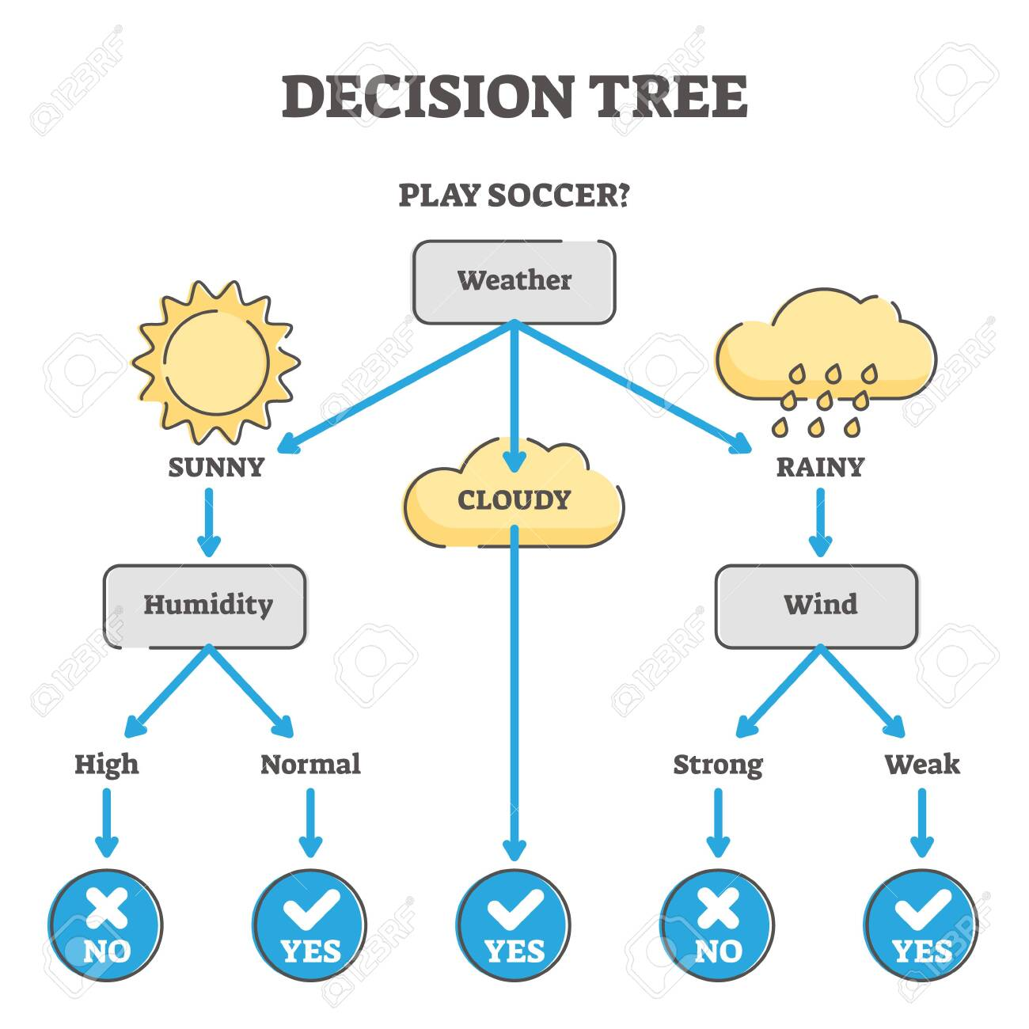

Slide 6
Types of Decision Tree:
1. Classification Tree
2. Regression Tree

Slide 7
Algorithms to build a decision tree:
1. Iterative Dichotomies (ID3) – Information Gain and Entropy are collectively called as ID3. This type of algorithm is used to build both classification and regression decision trees.
2. Gini Index : Based on the impurity decision tree can be build using Gini Index, but it can be used only for classification problems.

Slide 8
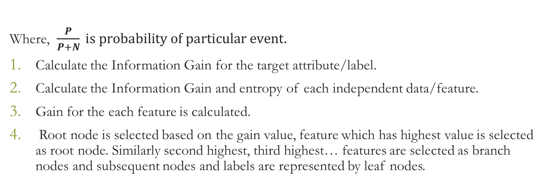
1. ID3 Approach/Algorithm
Where, $\frac{P}{P+N} is probability of particular event.$
Calculate the Information Gain for the target attribute/label.
Calculate the Information Gain and entropy of each independent data/feature.
Gain for the each feature is calculated.
Root node is selected based on the gain value, feature which has highest value is selected as root node. Similarly second highest, third highest… features are selected as branch nodes and subsequent nodes and labels are represented by leaf nodes.
Information Gain = $\frac{−P}{P+N}log2\left(\frac{P}{P+N}\right)−\frac{N}{P+N}log2(\frac{N}{P+N})$

Slide 9
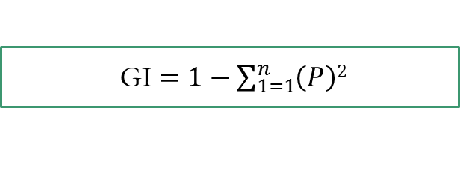
Gini Index:
It measures the impurity of the nodes.
It ranges between 0 and 1, 0 indicates Purity i.e homogeneity of nodes and 1 indicates random distribution of elements and 0.5 indicates equal distribution of elements / over some classes.
Feature having less gini index ( high Gini value) is selected as root node and so on branch nodes are selected and labels are represented as leaf nodes.
GI $=1−\sum_{1=1}^{n}{\left(P\right)2}$
GI = 1-[ P(+)₂ +P(-)²]

Slide 10
Entropy
It is measure of uncertainty of a random variable.
Higher the Entropy, higher the information content.
It ranges between 0 and 1.

